Slide 1
Week 7
Yufeng Zheng

Slide 2

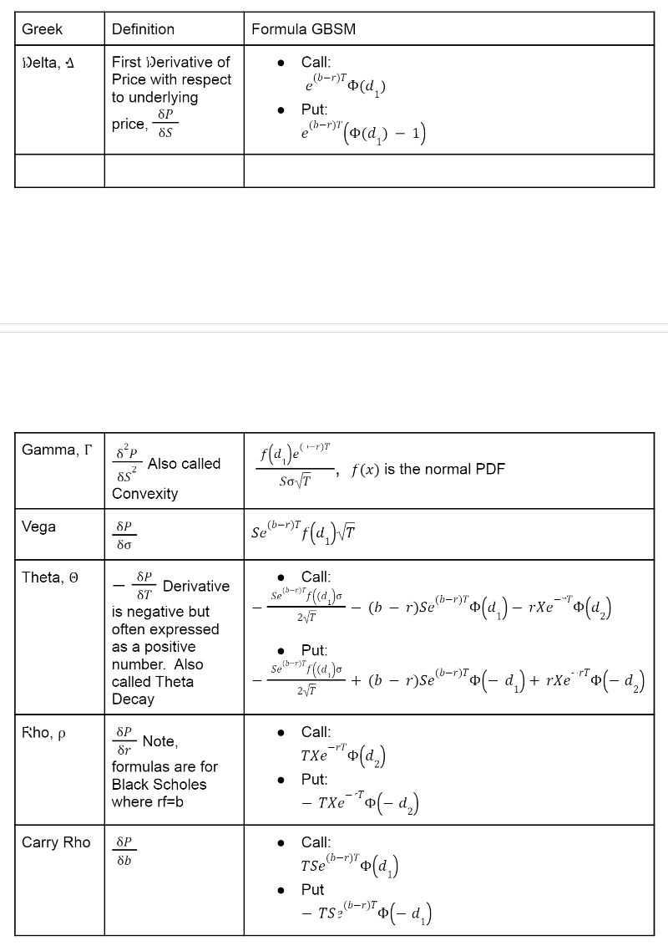
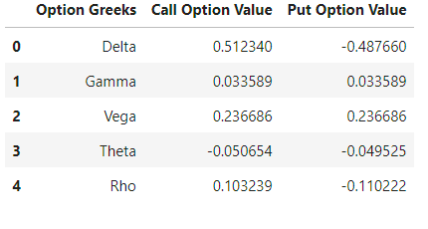
Question 1
For this question, I first calculate the Greek option values by using the formula in the lecture note. I basically change my Black-Scholes function to calculate each values.

Slide 3
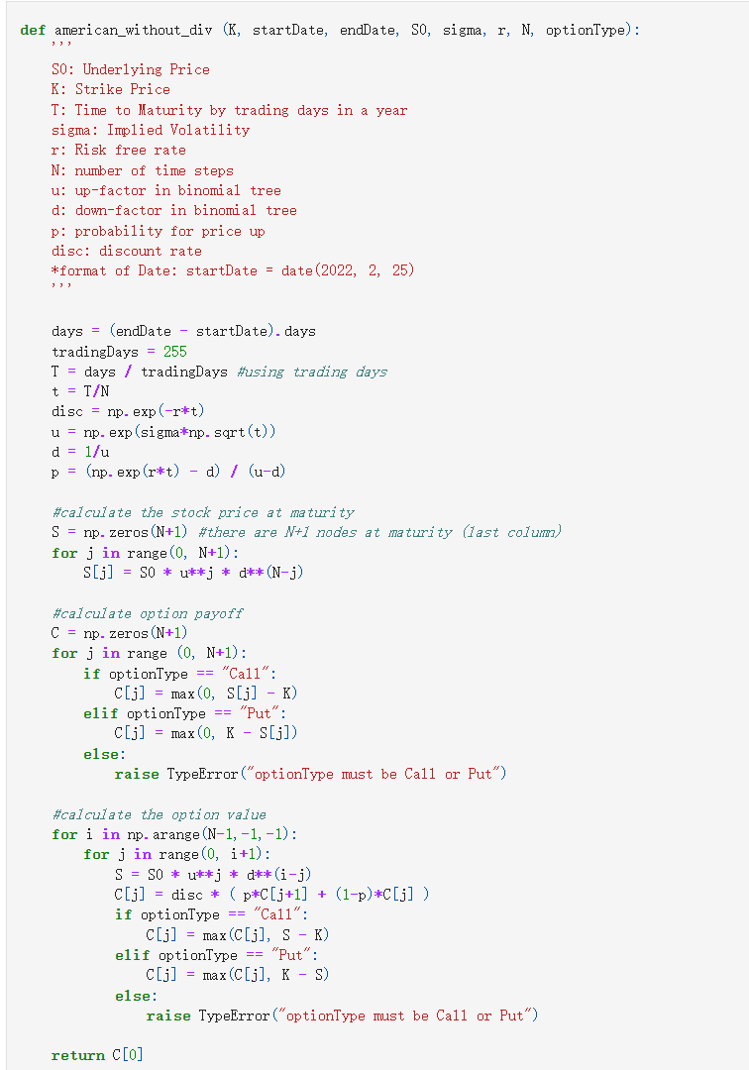
Then, I write the binomial tree model for American option price without dividends. Here is my function and my result.

Slide 4
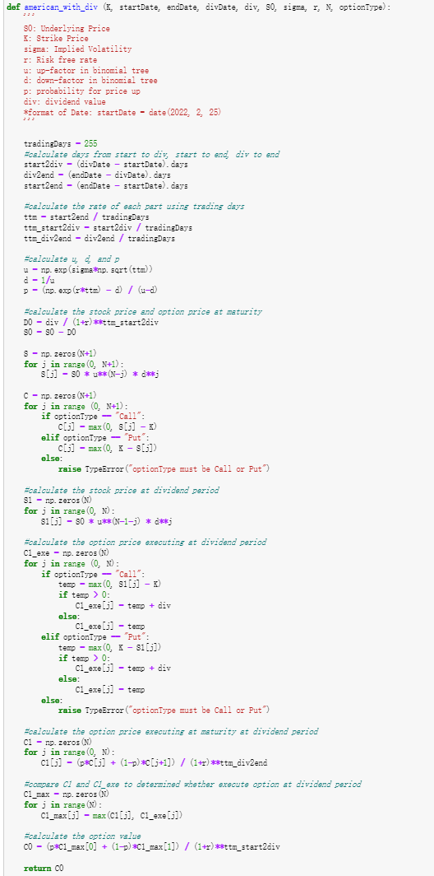
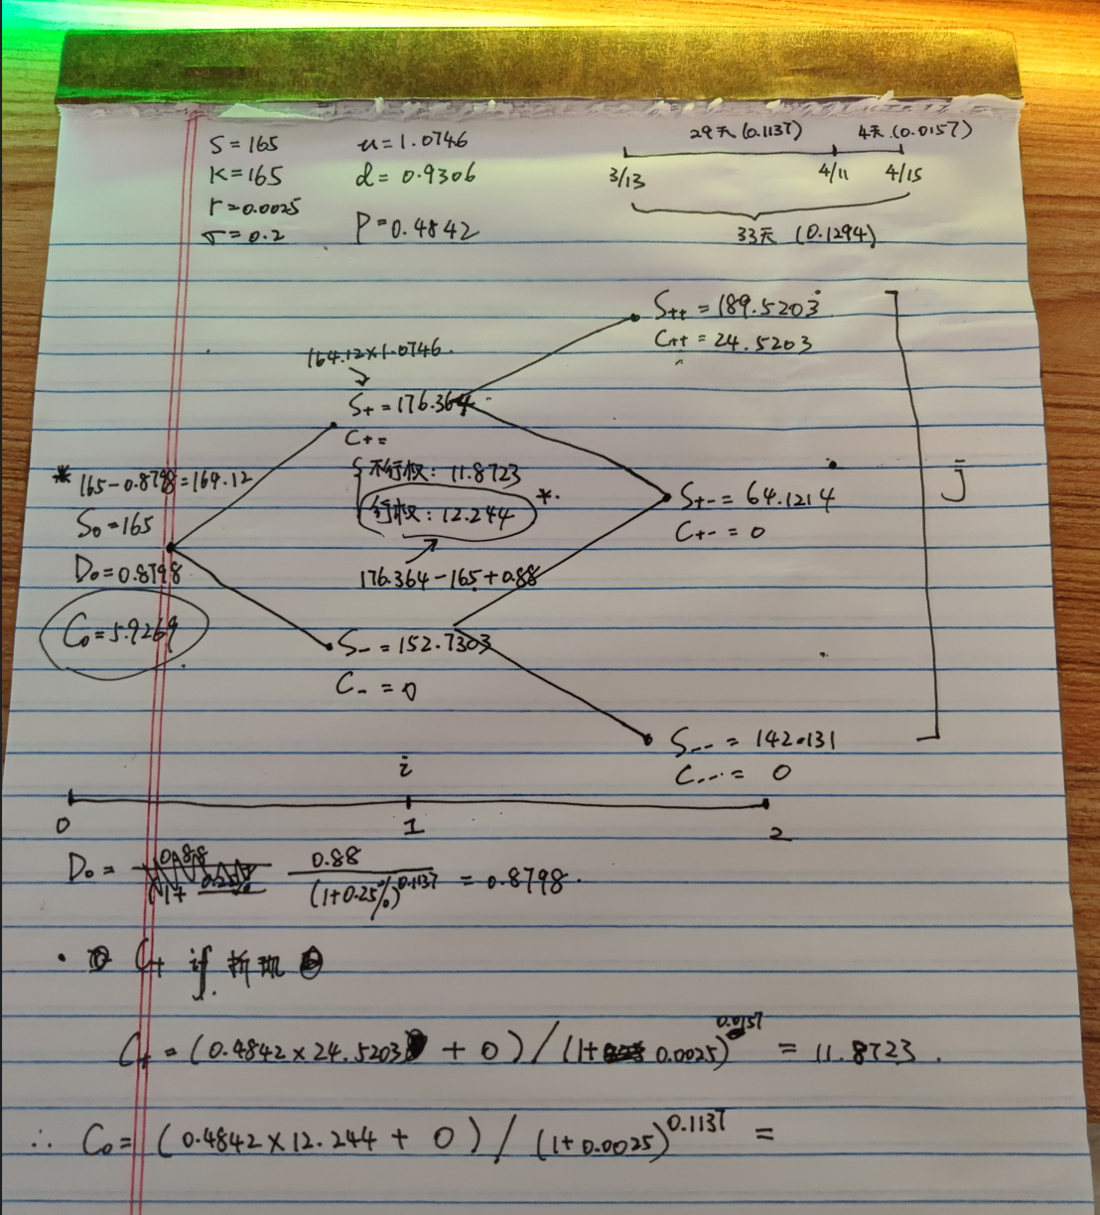
Then, I write the binomial tree model for American option price with dividends. Since with dividend is more complex than without dividends, I first calculate by myself on the paper, then I write code to transfer my idea into code.

Slide 5
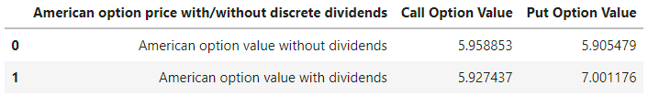
Then, I compare the option price under different situation

Slide 6
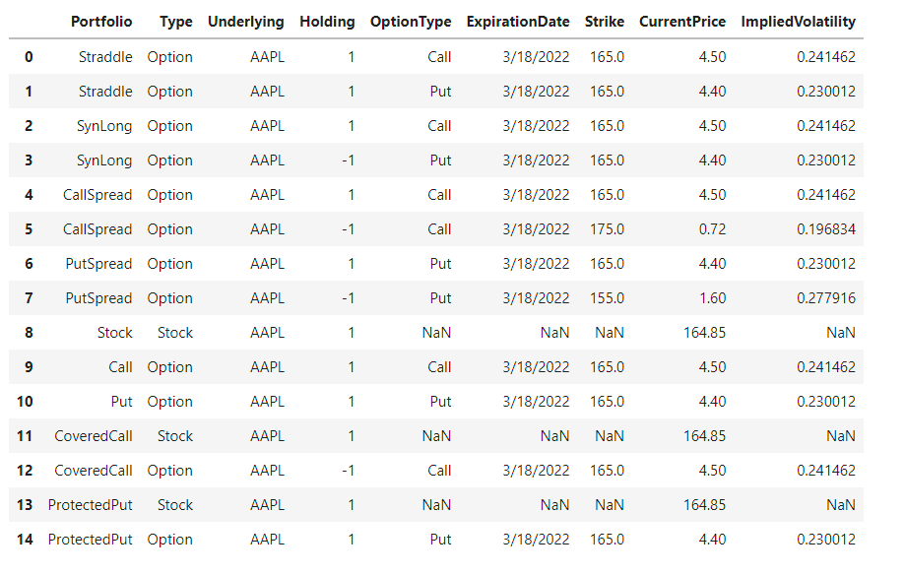
Question 2
For this question, I used the same idea from last week. First, I calculate the implied volatility.

Slide 7
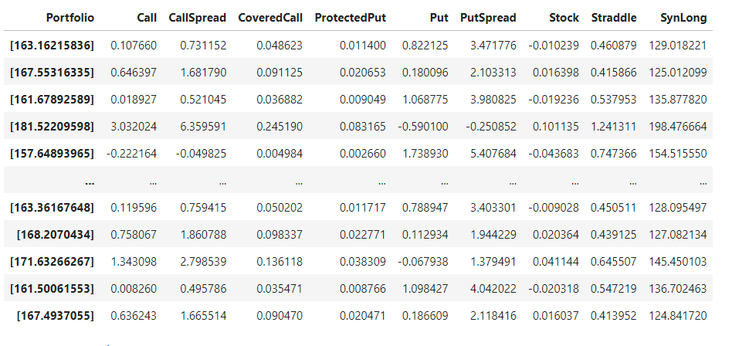
Then, I simulate price for each portfolio. I set my simulate size as 5000.

Slide 8
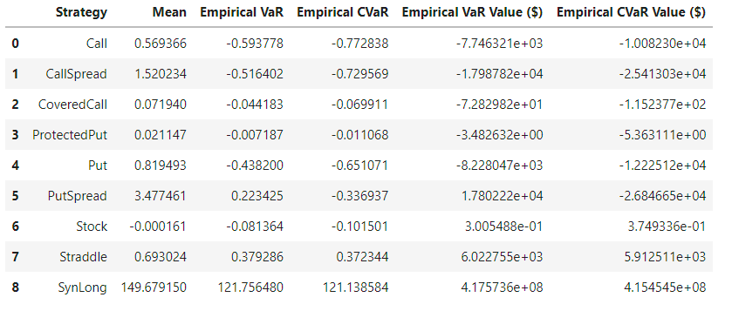
Then, I calculate the empirical VaR and CVaR for each strategy.

Slide 9
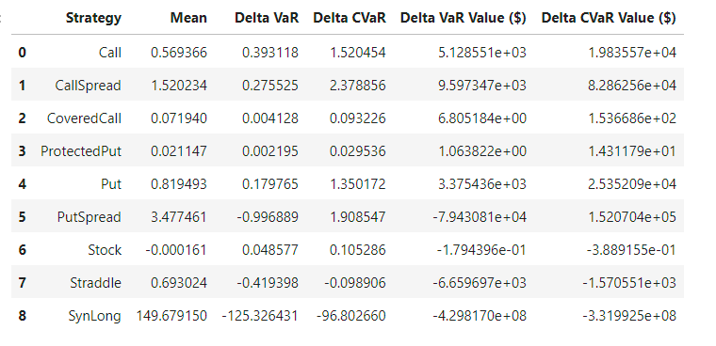
Also, I calculate VaR and CVaR using Delta-normal

Slide 10
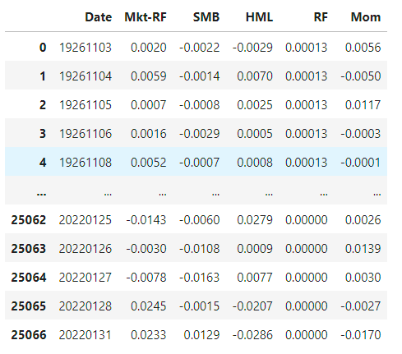
Question 3
Following the instruction, I divide 100 for each factor value to change percentage to the value. And I combine the 3 factors data with momentum data.

Slide 11
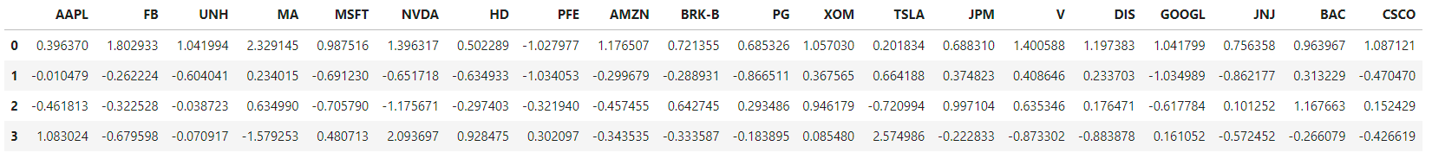
Then, I change daily return’s data to int64 type to easily merge two dataframe.
Then, applied the formula in the lecture note, I calculate the parameters for each stocks.

Slide 12
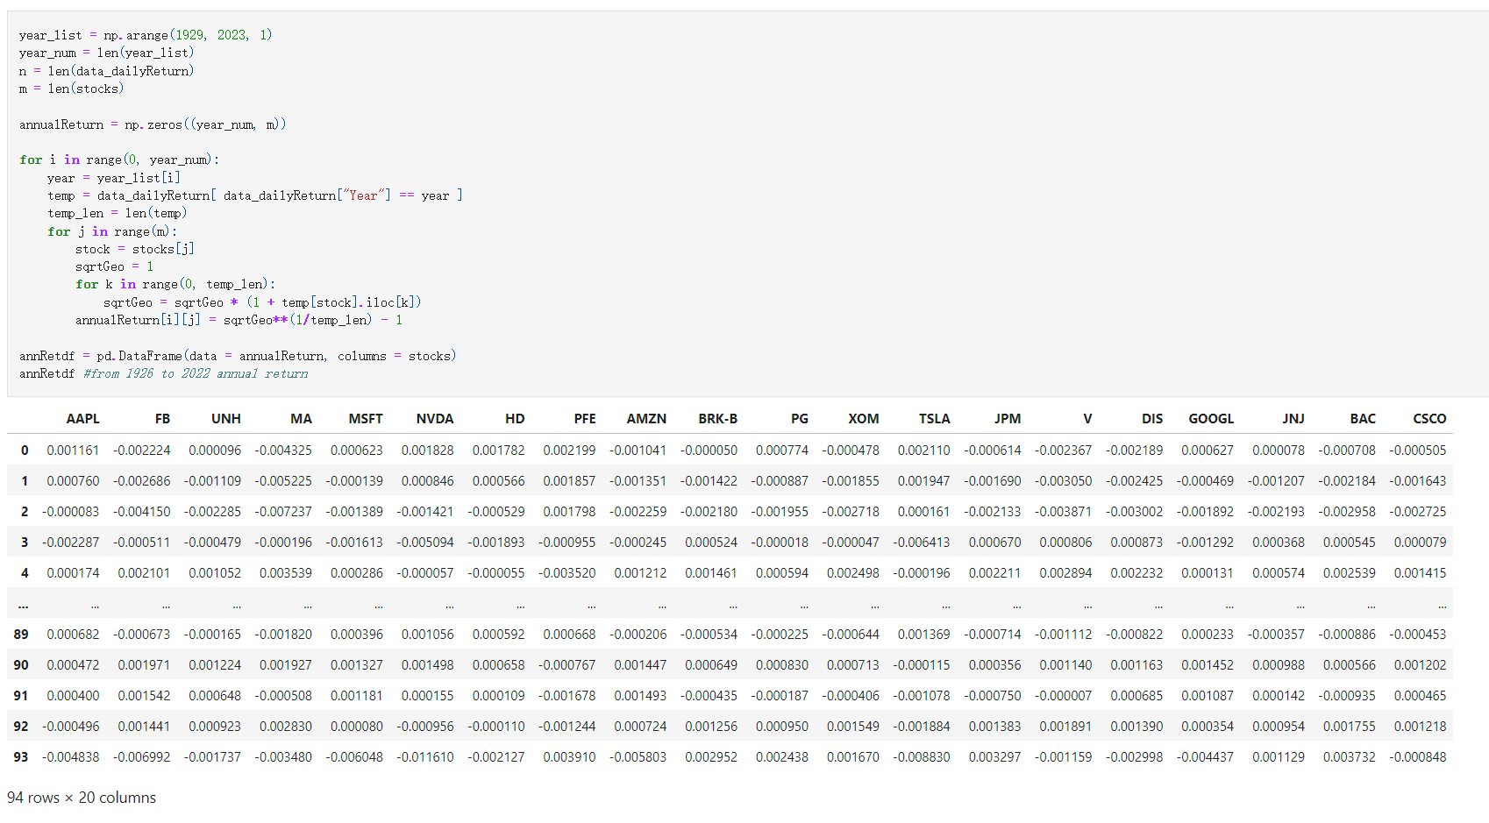
After I get the parameter’s value, I can calculate daily returns for each stock in the past 10 years.
After I get the daily return, I need to calculate the annual rate of return by using geometric returns.
First, I add a Year columns to the dataframe to split each years.
Second, I applied geometric return formula to calculate the annual return.

Slide 13
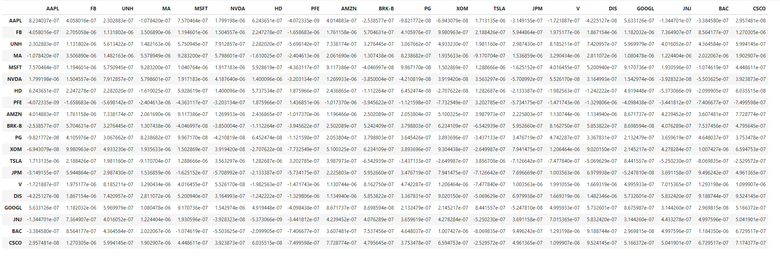
Applied covariance function to find annual covariance matrix for the 20 stocks

Slide 14
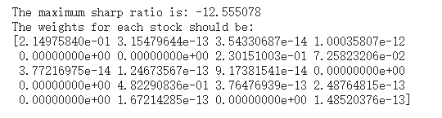
For the last part,

